Slide 1
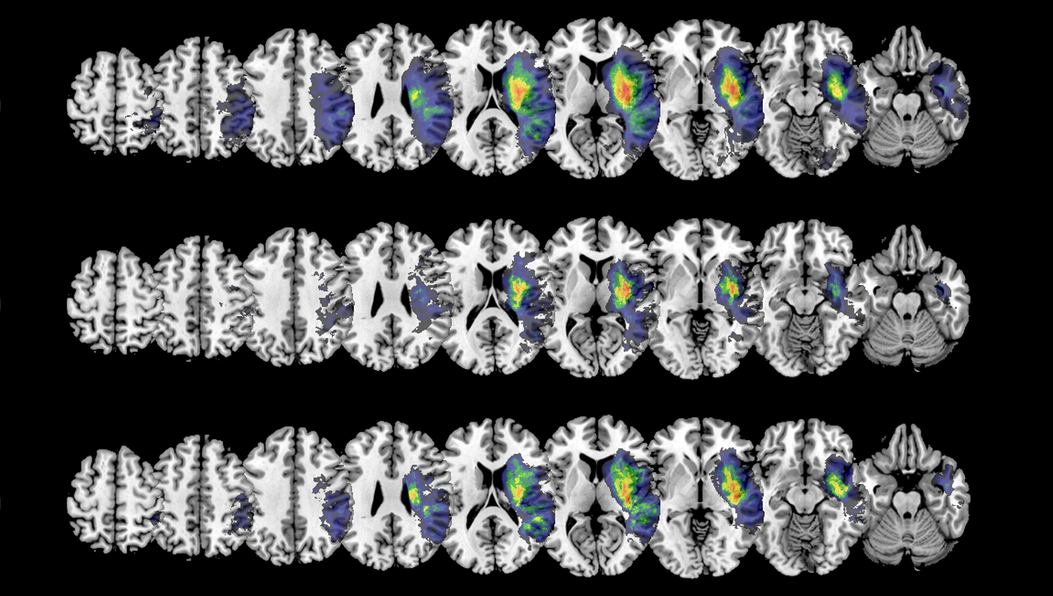
Interim Results II
Master Thesis: Sex Differences in the Association of Disconnections with Neglect

Slide 2
(Rough) Structure of the Thesis
Introduction
Sex Differences in Brain Connectivity
Sex Differences in Stroke
Visuospatial Neglect
Motivation
Data Analysis / Results
Voxel-based Lesion-Behaviour Mapping
Whole-Brain Disconnectivity
Region-to-Region Disconnectivity
Lesion-induced Increase in Shortest Structural Path Lengths (SSPLs)
Prediction of Patient Status
Discussion

Slide 3
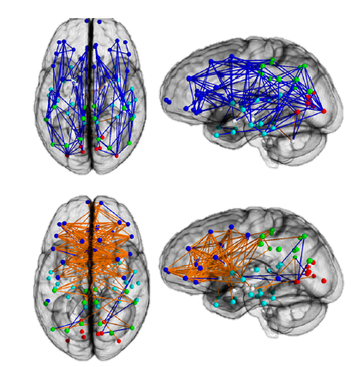
Intro: Sex Differences in Brain Connectivity
There are some small, but significant sex differences in cognition – but what are the neurological underpinnings?
Theory: Cognitive sex differences may arise from differences in brain connectivity and hemispheric asymmetry
Ingalhalikar et al. (2013):
Women have more inter-hemispheric connections, men have more intra-hemispheric connections
Men have higher hemispheric asymmetry / functional lateralisation than women

Slide 4
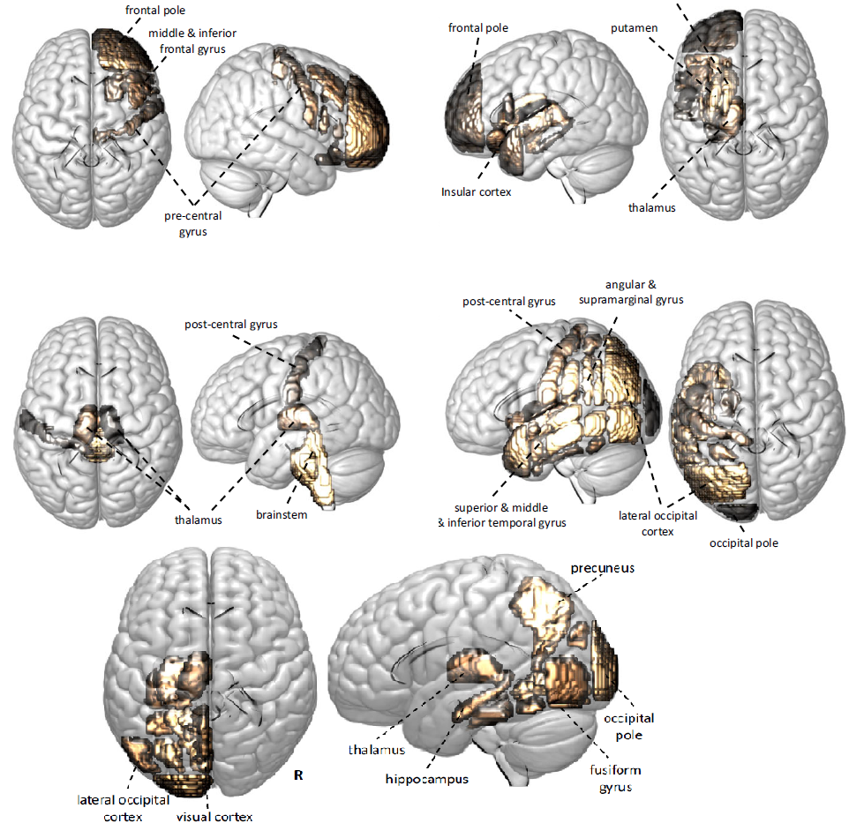
Intro: Sex Differences in Stroke
Women are older when experiencing their first stroke and suffer more severe effects
Not due to different lesion sizes
Bonkhoff et al. (2021):
More regions contribute to stroke severity in women
Effects only become significant post-menopause (>52 years)

Slide 5
Intro: Visuospatial Neglect
Sex differences?
Sex difference in (acute) neglect incidence: Women = 33%, Men = 27% (Hammerbeck et al., 2019)
Performance in diagnostic tests for neglect might be influenced by sex & age (Varnava & Halligan, 2007; but Kleinman et al., 2008)
Some studies suggest: neglect after WM lesions is more severe than after pure GM lesion → potentially due to network dysfunction caused by the disconnections (Bartolomeo et al., 2007)

Slide 6
Intro: Motivation
Sex has been shown to significantly affect cognition, brain anatomy & connectivity and stroke pathophysiology
But: Sex has largely been ignored in neglect research, as well as disconnectivity analyses so far
Focus on how sex affects disconnections (associated with neglect)
Briefly look into clinical & demographic data, as well as lesion overlays → “baseline“

Slide 7
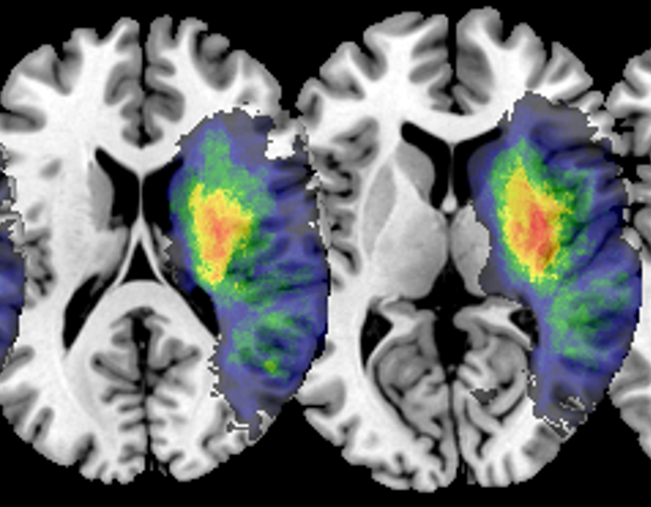
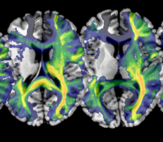
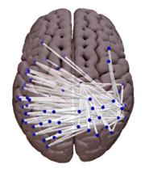
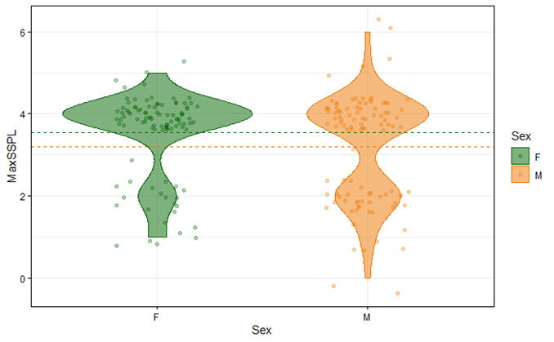
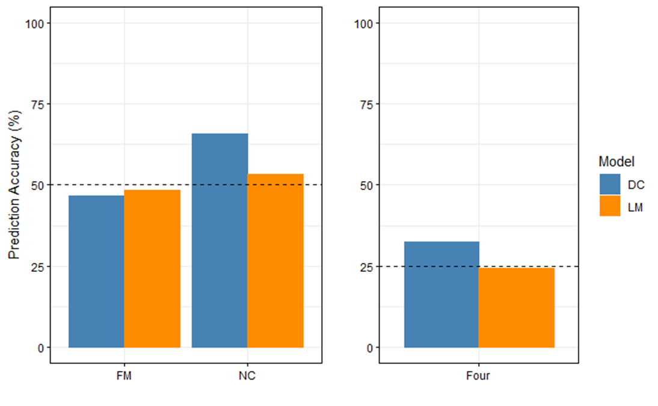
Overview: Results
Lesion
1
Whole-Brain Disconnection
2
Parcel-wise Disconnection
3
SSPL Increase
4
Prediction of Patient Status
5
Focus more on sex & disconnections, rather than neglect

Slide 8
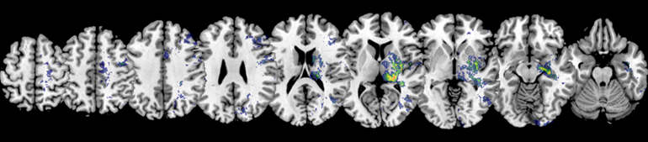
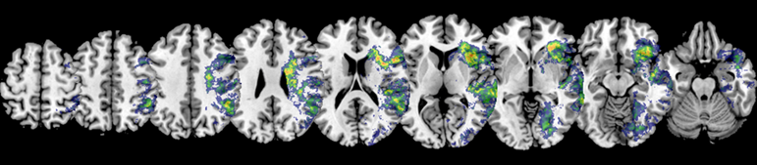
Lesion Subtraction – All Patients
1
Female
→ Thalamus
Male

Slide 9
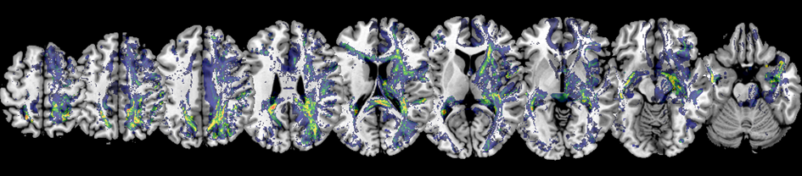
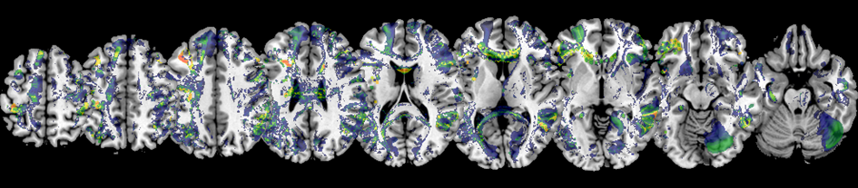
Disconnection Subtraction – All Patients
2
Female
→ RH intra
Male
→ inter

Slide 10
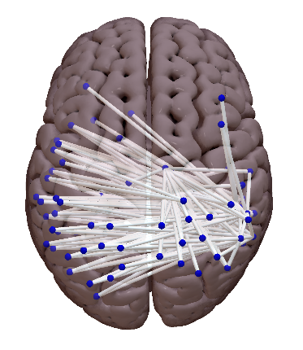
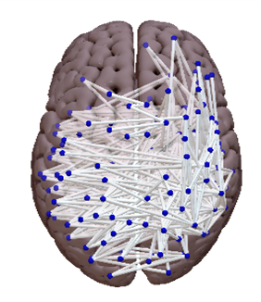
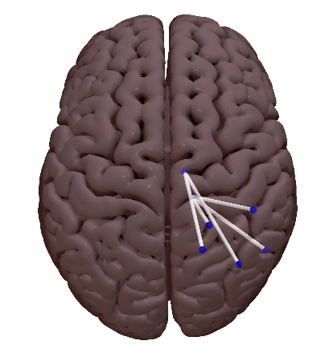
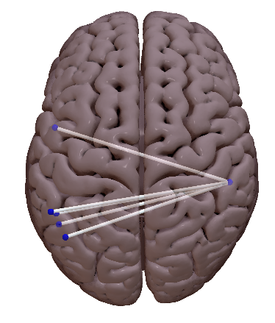
Significant ROI-to-ROI Disconnections
3
Female
Male
n = 205
71% interhemispheric
5 most signficant: intra. to Thalamus
n = 611
70% interhemispheric
5 most significant: inter. to right ITG

Slide 11
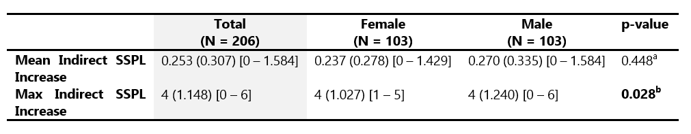
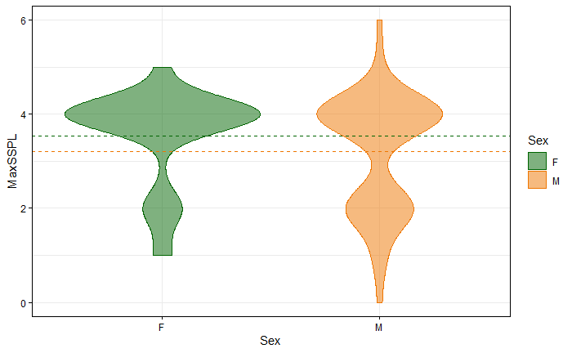
Shortest Structural Path Lengths (SSPLs)
4

Slide 12
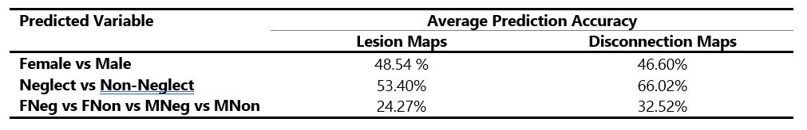

Prediction of Patient Status
5
1
2
3
1
2
3
Disconnections are better suited to predict patient status than just lesion maps alone

Slide 13
Discussion
Women have more (significant) intrahemispheric disconnections than men, likely because they have fewer of those connections in the first place (cf. Ingalhalikar et al., 2013)
Vice versa for men and interhemispheric (dis)connections
Lesions/Disconnections of Thalamus seem to be more strongly associated with higher stroke/neglect severity in women (cf. Bonkhoff et al., 2021)
Disconnections hold higher explanatory power when it comes to prediction of patient status → even if “only“ assessed indirectly (i.e., from the lesion maps)

